Slide 1

AAI 500 | LIVE SAMPLE CLASS
AAI 500 MASTERCLASS
Should AI Block
This Payment?
PAYMENT REVIEW
INR 50,000
New phone • Travel context • Known merchant
How probability, statistics, and Python turn a risk score into a decision you can defend
MODEL RISK SCORE
0.82
APPROVE
VERIFY
BLOCK
Daniel Smith, PhD, MBA
University of San Diego • Applied Artificial Intelligence

Slide 2


AAI 500 | MEET YOUR INSTRUCTOR
Meet Daniel Smith, PhD, MBA
Applied AI educator and analytics leader
USD AAI faculty
MS in Applied Artificial Intelligence
Analytics leader
Director-level experience
Teaching
28 years of experience
Arizona State
PhD and MBA
Harvard + Stanford
Recent AI executive development courses

Slide 3
AAI 500 | OPENING POLL
A payment receives a risk score of 0.82. What should the AI do?
Vote in Zoom or type A, B, C, or D in chat.
A
B
C
D
Block it now
Hold and verify
Approve it
Need more context
Treat the score as a decision.
Request another piece of evidence.
Avoid disrupting a legitimate customer.
A score alone is not interpretable.
Do not change your answer yet. We will revisit the same payment after each layer of AAI 500.

Slide 4
AAI 500 | THE CASE
Meet Asha: a legitimate customer in an unusual moment
The transaction is fictional; the statistical problem is very real.
Asha’s payment
Known customer
Five-year account history
INR 50,000
International travel booking
New device
First purchase from this phone
0.82
Travel context
Location changed this morning
model risk score
Known merchant
Prior legitimate purchases
The score ranks risk. It does not yet tell us the best action.
High amount
Larger than Asha’s typical payment
Teaching case uses synthetic data and a fictional customer.

Slide 5
AAI 500 | THE SCORE TRAP
What does 0.82 actually mean?
Four plausible interpretations produce four very different decisions.
01
02
03
04
82% chance of fraud
82nd percentile
82% precision
A raw model score
A calibrated probability claim
A relative ranking claim
A claim about flagged payments
A number needing validation
AAI 500 teaches you to interrogate the number before trusting the action.

Slide 6
AAI 500 | LEARNING PROMISE
Defend a decision—not merely quote a score
1
2
3
4
5
Audit the data
Reason with probability
Quantify uncertainty
Choose a model
Set a policy
What was measured, missing, or mislabeled?
How do base rates change the answer?
How much could the estimate move?
What structure links evidence to risk?
Which errors are acceptable—and to whom?
The technical skill is calculation. The professional skill is judgment under uncertainty.

Slide 7
AAI 500 | THE AAI 500 JOURNEY
Seven weeks build one defensible statistical-learning workflow
Each week answers a different question raised by Asha’s payment.
Data & statistical thinking
What exactly are we observing?
1
Bayesian networks
How does evidence propagate?
5
Probability & base rates
How likely is the evidence?
2
Regression & GLMs
How is risk estimated?
6
Sampling & simulation
Would another sample agree?
3
Classification & clustering
How does a score become action?
7
Intervals & inference
How precise is the claim?
4
Today’s masterclass compresses that journey into one case.
Based on the AAI 500 Weeks 1–7 instructional decks and course syllabus.

Slide 8
AAI 500 | SECTION 01
01
Data before models
A risk score inherits every strength—and every weakness—of the data used to create it.

Slide 9
AAI 500 | WEEK 1 | STATISTICAL THINKING
Before modeling fraud, define the cases, variables, and labels
The first model decision is often a data-definition decision.
DATA 1
DATA 2
DATA 3
CASES
VARIABLES
OUTCOME
One row per payment—not per customer or alert.
Amount, device, merchant, location, history, time.
Confirmed fraud, chargeback, or investigator judgment?
Four ways a clean-looking table can mislead
Missingness
Is travel context absent—or genuinely “no travel”?
Leakage
Does a feature reveal the outcome after the decision?
Label delay
How long before fraud is confirmed?
Representation
Which customers or merchants are under-sampled?

Slide 10
AAI 500 | WEEK 1 | THE ACCURACY PARADOX
A model can be 99% accurate—and completely useless
Suppose only 1% of 10,000 payments are fraudulent.
9,900
100
99%
legitimate payments
fraudulent payments
accuracy by approving everything
“APPROVE EVERY PAYMENT”
0 fraud caught
100 fraud missed
Accuracy ignores which class matters and what each error costs.

Slide 11
AAI 500 | SECTION 02
02
Probability changes the denominator
The question “How often does the alert catch fraud?” is not the same as “How often is an alert actually fraud?”

Slide 12
AAI 500 | WEEK 2 | CONDITIONAL PROBABILITY
Two probabilities sound similar—but reverse the conditioning
SENSITIVITY
PRECISION
P(Alert | Fraud)
P(Fraud | Alert)
Among payments that truly are fraud, how many receive an alert?
Among payments receiving an alert, how many truly are fraud?
The conditioning bar “|” tells us which group becomes the denominator.

Slide 13
AAI 500 | WEEK 2 | BAYES BY COUNTS
Start with 10,000 payments and let the base rate do its work
Assume 1% fraud, 90% sensitivity, and a 5% false-positive rate.
90 alerted
100 fraud
YOUR PREDICTION
true positives
1% of all payments
Of the 585 alerts,
how many are fraud?
10 not alerted
10,000
payments
false negatives
A > 50%
B 25–50%
C 10–25%
D < 10%
495 alerted
9,900 legitimate
false positives
99% of all payments
9,405 not alerted
true negatives

Slide 14
AAI 500 | WEEK 2 | THE REVEAL
A strong detector can still produce mostly false alarms
The base rate—not just model quality—determines what an alert means.
90
495
585
PRECISION
+
=
90 / 585
true positives
false positives
total alerts
15.4%
About 5 in every 6 alerts would interrupt a legitimate payment.

Slide 15
AAI 500 | WEEK 2 | BAYESIAN UPDATING
Bayes combines prior prevalence with the likelihood of the evidence
Posterior odds = Prior odds × Likelihood ratio
1% base rate
90% vs 5%
15.4% among alerts
PRIOR
EVIDENCE
POSTERIOR
Fraud is rare before we see the alert.
The alert is more likely under fraud.
Risk rises—but not to certainty.
Bayes is not a trick formula. It is disciplined evidence updating.

Slide 16
AAI 500 | SECTION 03
03
How certain are we?
One validation result is a sample. A defensible claim shows how much that result could change under repetition.

Slide 17
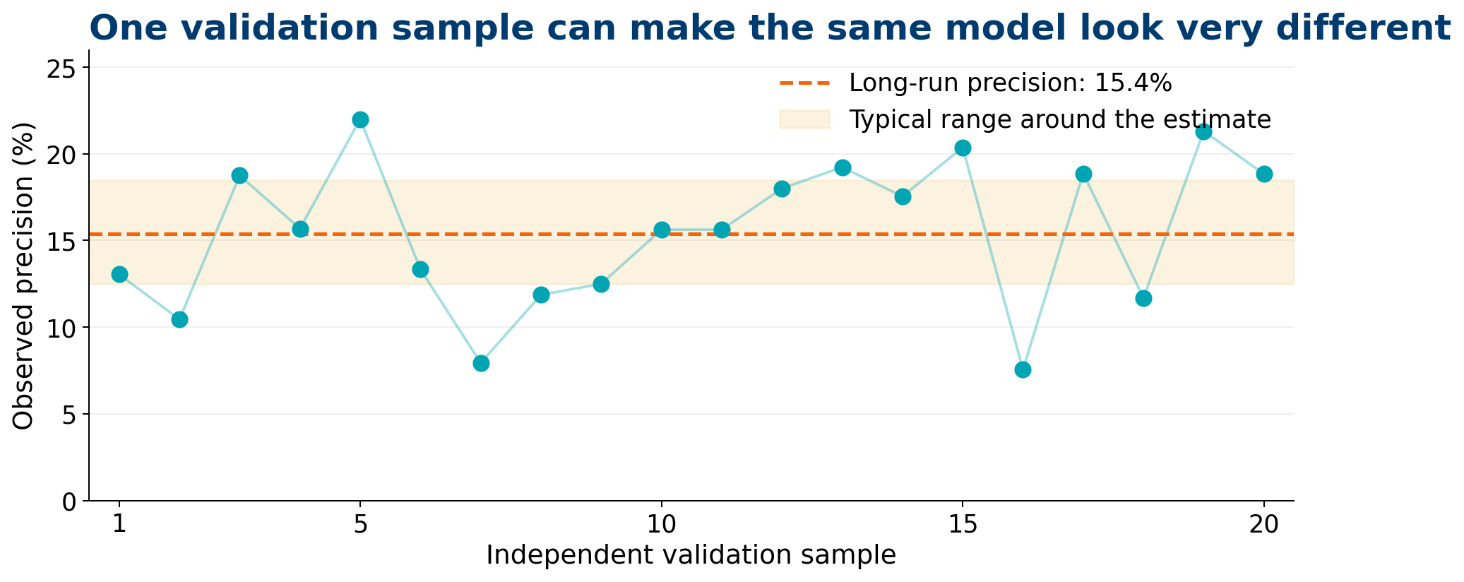
AAI 500 | WEEK 3 | SAMPLING DISTRIBUTIONS
The same model can look very different in another validation sample
Sampling variability is not a software bug—it is part of the evidence.
What changed?
The model stayed fixed. The customers and payments in the sample changed.
What should we report?
A point estimate plus standard error, interval, and sample context.
Synthetic illustration: 20 independent validation samples
Synthetic illustration for teaching; long-run precision fixed at 15.4%.

Slide 18
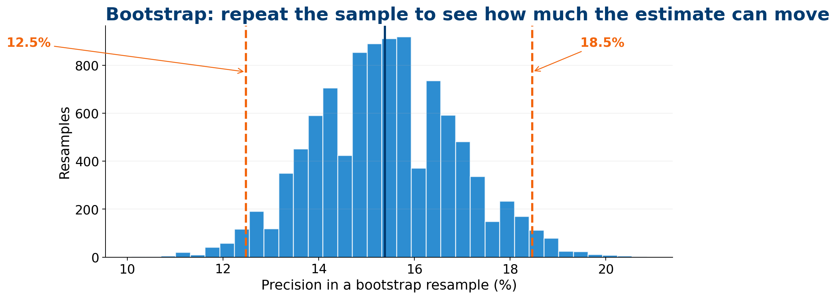
AAI 500 | WEEK 3 | BOOTSTRAP
When the formula is awkward, resample the observed data
The bootstrap repeats the analysis to estimate how much the statistic can move.
Sample rows with replacement
1
Recalculate precision
2
Repeat thousands of times
3
Use the empirical distribution
4
10,000 bootstrap resamples of precision
Synthetic resampling illustration; values rounded for presentation.

Slide 19
AAI 500 | WEEK 4 | INTERVAL ESTIMATION
A point estimate sounds certain. An interval shows the decision risk.
15.4%
Planning interpretation
95% bootstrap interval
observed precision
Using this bootstrap procedure, values from 12.5% to 18.5% are plausible for the underlying precision.
12.5%
18.5%
The interval does not eliminate uncertainty. It makes uncertainty visible enough to manage.

Slide 20
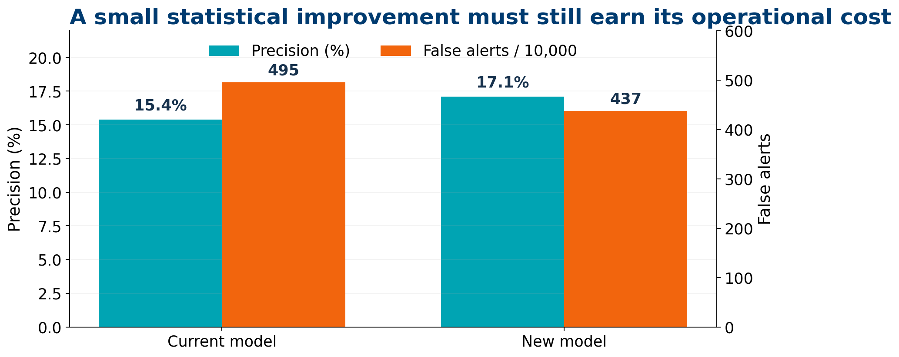
AAI 500 | WEEK 4 | PRACTICAL EVIDENCE
A model improvement must still earn its operational cost
More precision can coexist with almost the same number of false alerts.
Statistical question
Is the difference larger than expected sampling noise?
Decision question
Does the gain justify retraining, review capacity, and customer friction?
A p-value cannot decide what the improvement is worth.
Synthetic model comparison
Synthetic values for teaching; not a claim about any payment platform.

Slide 21
AAI 500 | SECTION 04
04
From model score to policy
Models estimate. Metrics diagnose. Thresholds encode consequences. People remain accountable for the policy.

Slide 22
AAI 500 | WEEK 5 | BAYESIAN NETWORKS
A Bayesian network makes evidence paths visible
Instead of one opaque score, the model shows how evidence changes the fraud probability.
New device
Account takeover
Alert
Travel context
Fraud risk
Unusual behavior
Step-up verification
High amount
Evidence updates connected beliefs; conditional independence keeps the model compact and explainable.
Conceptual network for teaching; arrows are not claims of causality.

Slide 23
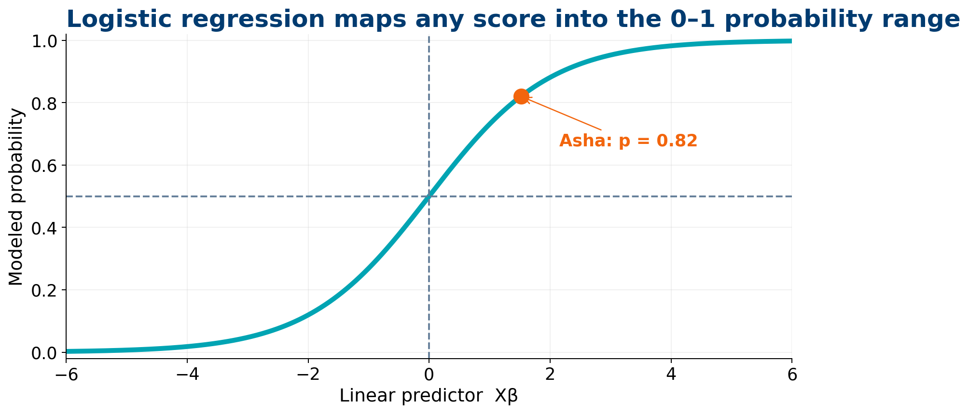
AAI 500 | WEEK 6 | LOGISTIC REGRESSION
Logistic regression maps evidence into a 0–1 probability range
Synthetic-case assumption: after calibration, 0.82 is treated as an estimated probability.
Linear predictor
β₀ + β₁x₁ + ··· + βₚxₚ
Inverse-logit
Maps the linear predictor into a 0–1 probability.
Still required
Diagnostics, validation, calibration, and context.
Asha’s synthetic score shown at 0.82
Synthetic logistic curve for teaching.

Slide 24
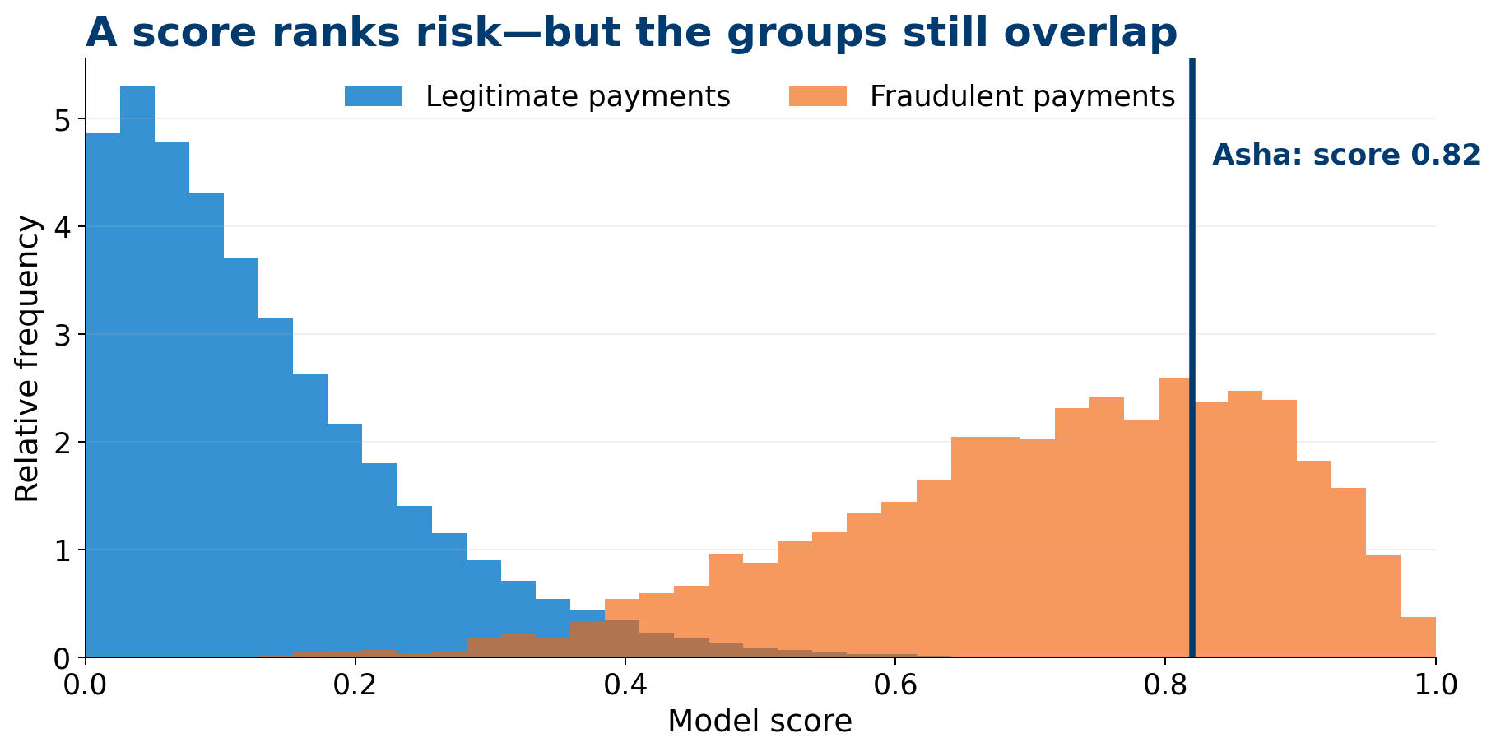
AAI 500 | WEEK 7 | CLASSIFICATION SCORES
A score ranks risk—but the groups still overlap
No threshold perfectly separates legitimate and fraudulent payments.
Good news
Higher scores contain more fraudulent payments.
Hard truth
Some legitimate payments also receive high scores.
The threshold changes the tradeoff between missed fraud and customer interruption.
Synthetic score distributions; Asha’s score marked at 0.82
Synthetic score distributions for teaching.

Slide 25
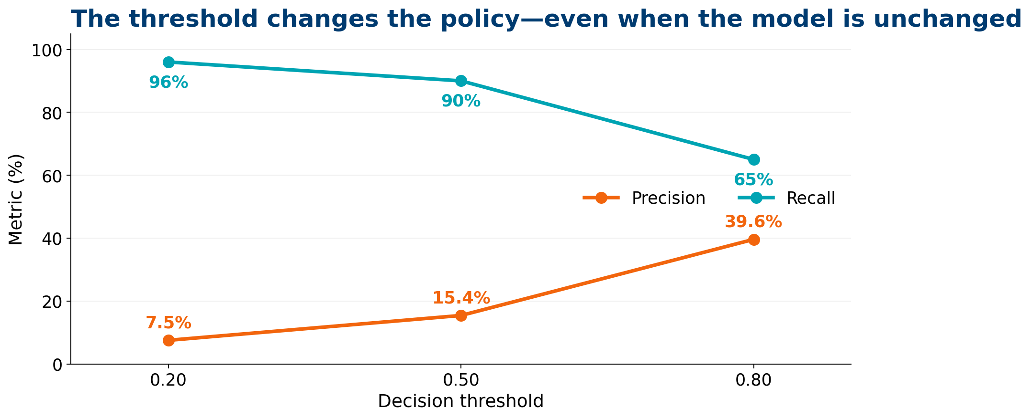
AAI 500 | WEEK 7 | THRESHOLD CHOICE
The threshold changes the policy—even when the model is unchanged
Which operating point would you choose for a high-value payment?
0.20
96% recall • 7.5% precision
Catch nearly everything; interrupt many
0.50
90% recall • 15.4% precision
Balanced screening point
0.80
65% recall • 39.6% precision
Fewer interruptions; more missed fraud
Vote: low, medium, or high threshold—and explain whose cost you prioritized.
Synthetic operating points for classroom discussion.

Slide 26
AAI 500 | WEEK 7 | METRICS
Each metric protects a different stakeholder question
A single dashboard number can conceal the consequences that matter.
1
2
3
4
5
Accuracy
Recall
Precision
Specificity
AUROC
How often is any prediction correct?
Of all fraud, how much did we catch?
Of all alerts, how much was fraud?
Of legitimate payments, how much passed?
How well does the score rank across thresholds?
Can mislead with rare fraud.
Protects against missed fraud.
Protects customers and reviewers.
Protects the negative class.
Does not choose the policy.
Metrics describe performance. The decision still requires values, costs, and governance.

Slide 27
AAI 500 | WEEK 7 | DECISION POLICY
A three-band policy can be safer than a single hard threshold
The highest-value action is often to gather one more piece of evidence.
LOW RISK
UNCERTAIN
VERY HIGH RISK
0.00–0.39
0.40–0.84
0.85–1.00
Approve
Step-up verification
Hold + human review
Monitor after the fact.
Ask for device, biometric, or travel confirmation.
Do not make an irreversible decision blindly.
ASHA • 0.82
Illustrative policy bands; real deployment thresholds require validation and governance.

Slide 28
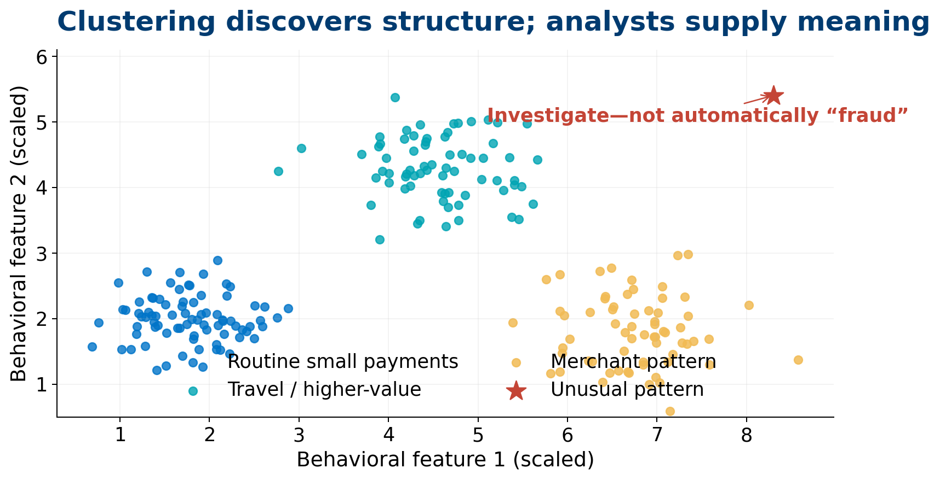
AAI 500 | WEEK 7 | CLUSTERING
Clustering discovers structure—but analysts supply meaning
Unsupervised patterns can reveal customer behavior, merchant segments, or novel anomalies.
Useful for
Segmentation, anomaly discovery, and feature engineering.
Not proof of
Fraud, causality, or naturally “true” groups.
Human task
Validate and interpret the pattern.
Synthetic behavioral clusters
Synthetic clusters for teaching.

Slide 29
AAI 500 | PYTHON IN AAI 500
Python makes every statistical decision inspectable and reproducible
Students move from question to code to evidence—not from library call to blind output.
# 1. Define the target and split the data
X_train, X_test, y_train, y_test = train_test_split(...)
# 2. Estimate risk
model = LogisticRegression().fit(X_train, y_train)
risk = model.predict_proba(X_test)[:, 1]
# 3. Convert score into policy
alert = risk >= 0.50
# 4. Evaluate consequences
classification_report(y_test, alert)
QUESTION
What decision must the model support?
CODE
Make assumptions and transformations visible.
EVIDENCE
Report uncertainty and multiple metrics.
POLICY
Match the threshold to consequences.
The notebook becomes a transparent record of how the decision was produced.
Illustrative Python workflow; exact implementation depends on the data and policy.

Slide 30
AAI 500 | RETURN TO ASHA
Now decide: what should the system do with Asha’s payment?
Use the evidence accumulated across all seven weeks.
ASHA’S PAYMENT
OPTION
RECOMMENDED
OPTION
INR 50,000
AUTO-BLOCK
STEP-UP VERIFY
AUTO-APPROVE
0.82
Too much certainty from one score.
Gather evidence before an irreversible action.
Ignores the elevated risk signal.
model risk score
Known customer
New device
Travel context
Known merchant
Verify device or travel; approve if confirmed, otherwise review.
Illustrative teaching recommendation—not a universal payment policy.

Slide 31
AAI 500 | THE SEVEN-WEEK TAKEAWAY
AAI 500 teaches you to turn uncertainty into a decision you can defend.
1
Define the data
5
Update beliefs transparently
2
Respect base rates
6
Fit and diagnose the model
3
Measure sampling variation
7
Choose metrics and policy
4
Report intervals and evidence
DATA → PROBABILITY → UNCERTAINTY → MODEL → POLICY

Slide 32
AAI 500 | BACKUP | CASE ASSUMPTIONS
The arithmetic behind the 15.4% precision result
ASSUMPTION
VALUE
COUNT INTERPRETATION
Fraud prevalence
1.0%
100 of 10,000
Sensitivity / recall
90.0%
90 of 100 fraud alerted
False-positive rate
5.0%
495 of 9,900 legitimate alerted
Total alerts
585
90 true + 495 false
Precision
15.4%
90 ÷ 585
All values are synthetic and rounded. They are selected to make the base-rate effect easy to see.

Slide 33
AAI 500 | DISCUSSION
?
Questions?
Which part of the decision surprised you most—and what would you test next?
Probability • Statistics • Python • Judgment

